Slide 1
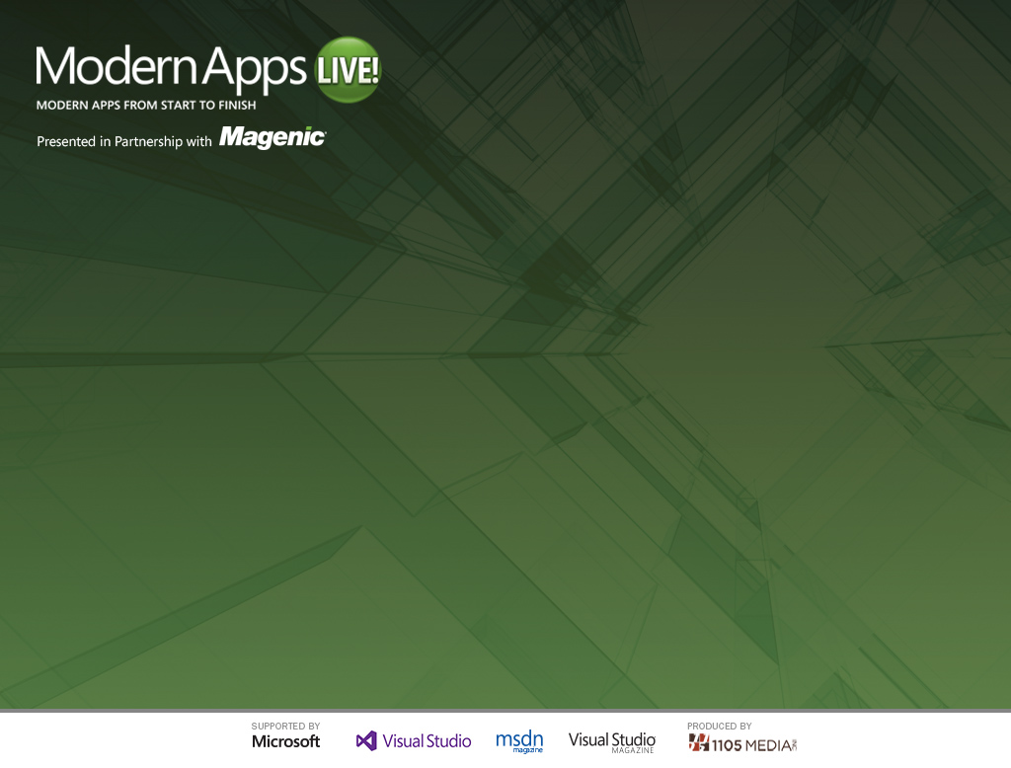
Data Access and SQL Server
Steve Hughes
Practice Lead
Level: Intermediate

Slide 2
Topics for the Session
Data Access Methodology
Database Design Strategy
Target Database Platform
Build and Deployment of the Database
Additional Storage Options

Slide 3
Some of the questions…
Who drives the design of the database?
Where should the data be located?
What kind of data?
Which is first, DB design or Data Access?
How much influence should the data access technology have over the database?
Normalization or object oriented?

Slide 4
Goals of Data Access Framework
Development efficiencies
Database performance
Flexible implementation
Supports code generation
Supports prebuilt database
Separate database interaction from development
Code to work with data without regard for the database SQL syntax

Slide 5
Data Access: Entity Framework
Ease of development
.NET
LINQ query support
Mockable for Unit Testing
Good for developer-driven team
Speeds overall development of application
Ease of deployment
The EF was specifically structured to separate the process of mapping queries/shaping results from building objects and tracking changes. This makes it easier to create a conceptual model which is how you want to think about your data and then reuse that conceptual model for a number of other services besides just building objects. (Source: Daniels Simmon – MSDN Blogs)

Slide 6
Chicken or the Egg? Code first or database first?
EF Code Generation vs DBA Code Generation
EF – Code First
EF – Model First
DBA – Database First
Decision Criteria
Resource Availability
Design Quality
Existing Database

Slide 7
Designing the Database
Database Design Considerations
User Experience
Data Quality
Ease of Development
Durability
Designed from UX to DB to EF Model
Collaborative DB Design
Final Result Created by DBA

Slide 8
Building the Database
SQL Server Data Tools
Script vs Table Design
Combination of both
Naming Conventions
Building the Database
Stored Procedures, When and Why?
EF generated queries vs stored procedures
Source Control

Slide 9
Target DB Platform
3 Options:
1. SQL Server on Premise
2. SQL Server in an Azure VM
3. Azure SQL Database
Decision Criteria
Cost
Licensing, hardware, maintenance
User Experience
Performance, accessibility, proximity
Ease of Use
Design tools, deployment options

Slide 10
Deploying the Database
Automated vs Manual
DBA approval of changes
Two DB Targets – Using Publish
Development Server
Production Server
Data Tier Application, Why Not?
Complexity and size of application
Managing Users and Logins
SQL Database nuances

Slide 11
Database Optimization and Maintenance
Monitoring Your Azure SQL Database
Data management views
Windows Azure Management console
Dashboard, Monitor, Configure
Index strategies
Indexed for EF access
Indexed for reporting
Backing Up Azure SQL Databases
BACPAC vs data migration

Slide 12
Using Azure Storage
Table Storage vs SQL Database
Why or why not?
Intelligent Use of Storage Technology
Using blob storage for images
Using blog storage for DB backups via bacpac

Slide 13
Retrieving Data from Azure Storage
Integrating Azure Storage data into the solution
EF with OData
Blob Service REST API
Linking to Azure Storage data in the Database

Slide 14
Enterprise Proofing Your Database
Scaling for data size
Azure SQL Database size limitations and sharding
Migrating to on premise or VM if required
Scaling for data users
Performance considerations
Expanding reporting capability
Adding a data mart or data warehouse
BI strategies covered in more detail in the last session

Slide 15
Q & A

